Slide 1
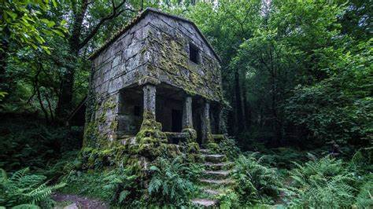

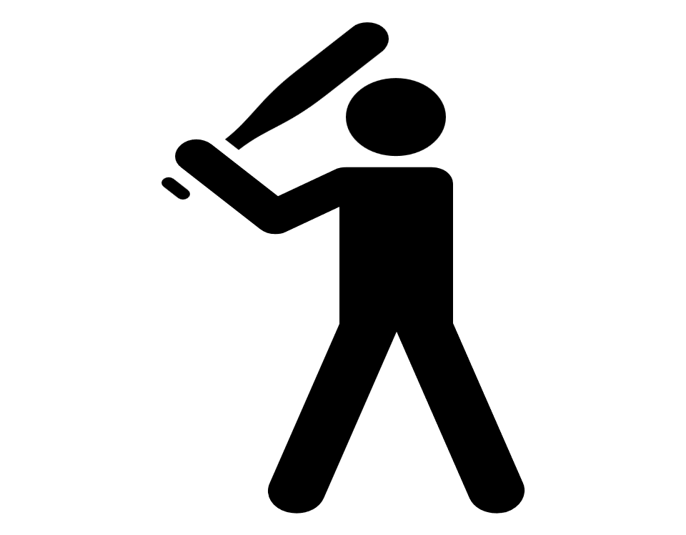
I’m Mhico Dela Cruz
My sports

Slide 2



what?
My sports
Where?
Why?

Slide 3
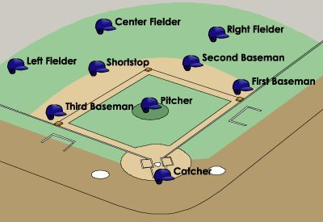
WHAT?
how is baseball played then you have defense, defense is when the player of the team in the field is called pitcher

Slide 4
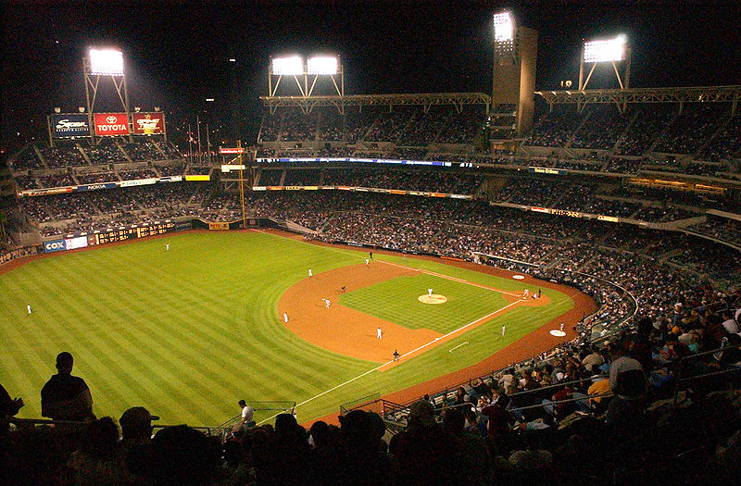
WHERE?
The starting point for much of the action on the field is home plate (officially "home base"), a five-sided slab of white rubber. One side is 17 inches (43 cm) long, the two adjacent sides are 8.5 inches (22 cm). The remaining two sides are approximately 11 inches (30 cm) and set at a right angle. The plate is set into the ground so that its surface is level with the field. The corner of home plate where the two 11-inch sides meet at a right angle is at one corner of a 90-foot (27.43 m) square. The other three corners of the square, in

Slide 5
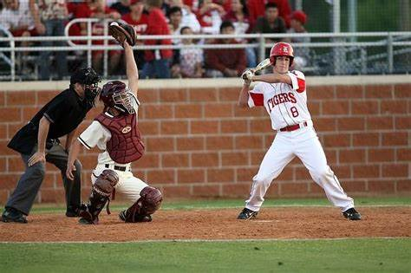
WHY?
That is what baseball has been called for the longest time. Whether people watch games or play themselves, there is no denying that they are completely enamored by baseball. As a matter of fact, many would claim that there is no other sport like baseball.

